Slide 1

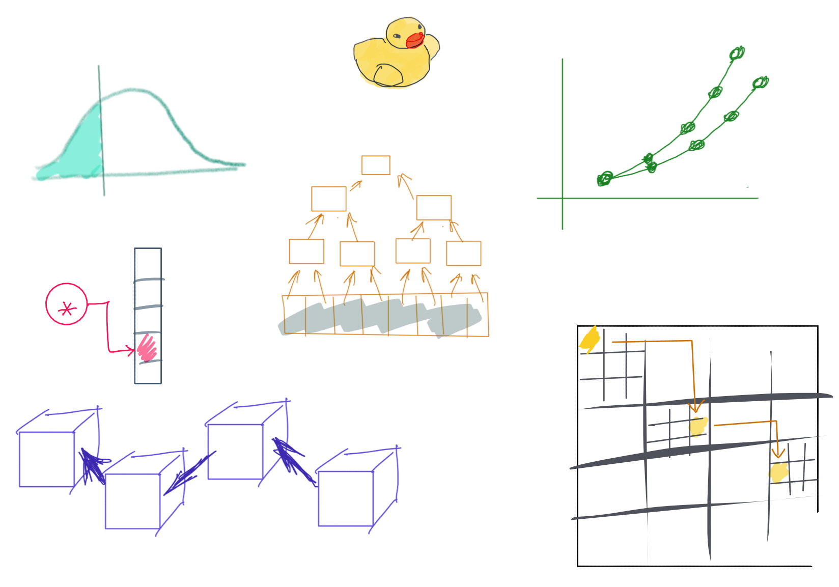

Slide 2
CSS342 Data Structures, Algorithms, and Discrete Mathematics (I)

Slide 3
Class Materials
Learn to learn
Write Solid Code
Programming Languages
C++
Data Structure
Array
List
Map (Dictionary)
Tree
Graph (maybe)
Algorithm
Search
Sort
Recursion
Complexity analysis
Computation Theory
Math induction & Propositional logic

Slide 4


C++
Basics:
Function
Loop
If-else
Primitive types
int, float
array
struct
Intermediate:
Template
Class
Pointer (new & delete)
Reference
STL containers
Advanced:
OOP
Smart pointers
Exception
File I/O
Makefile

Slide 5
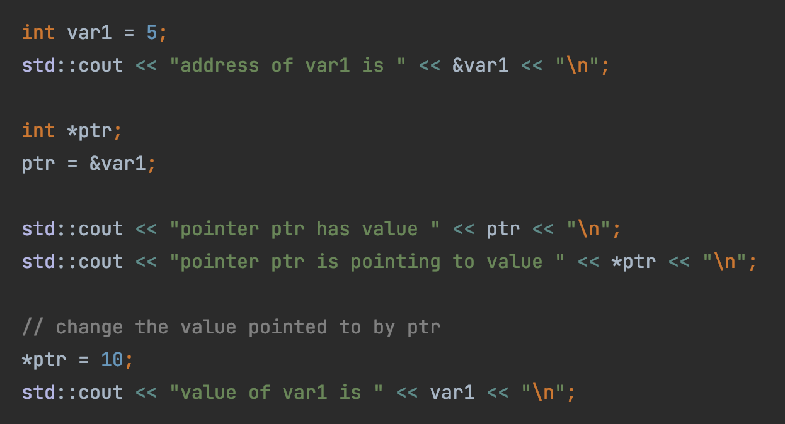

Pointer
Hexadecimal Address
0x0
1 byte (8 bits)
0x8
0x10
0x18
Var1 (5)
sizeof(int)
4 bytes
… …
ptr (0x18)
sizeof(int*)
8 bytes
Code here

Slide 6
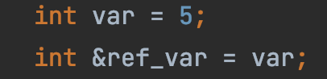
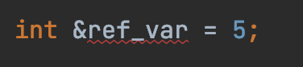
Reference
Hexadecimal Address
0x0
1 byte (8 bits)
0x8
0x10
0x18
Reference: a label (new name) to an existing variable
… …
Var1 (5)
ref_var
What’s wrong with this?

Slide 7
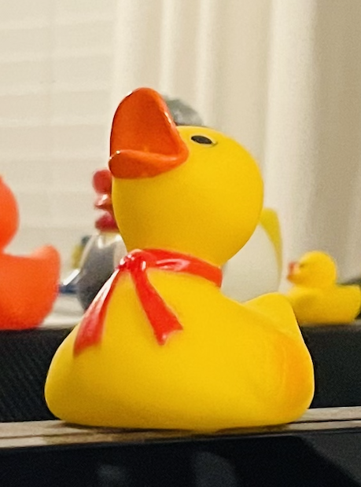
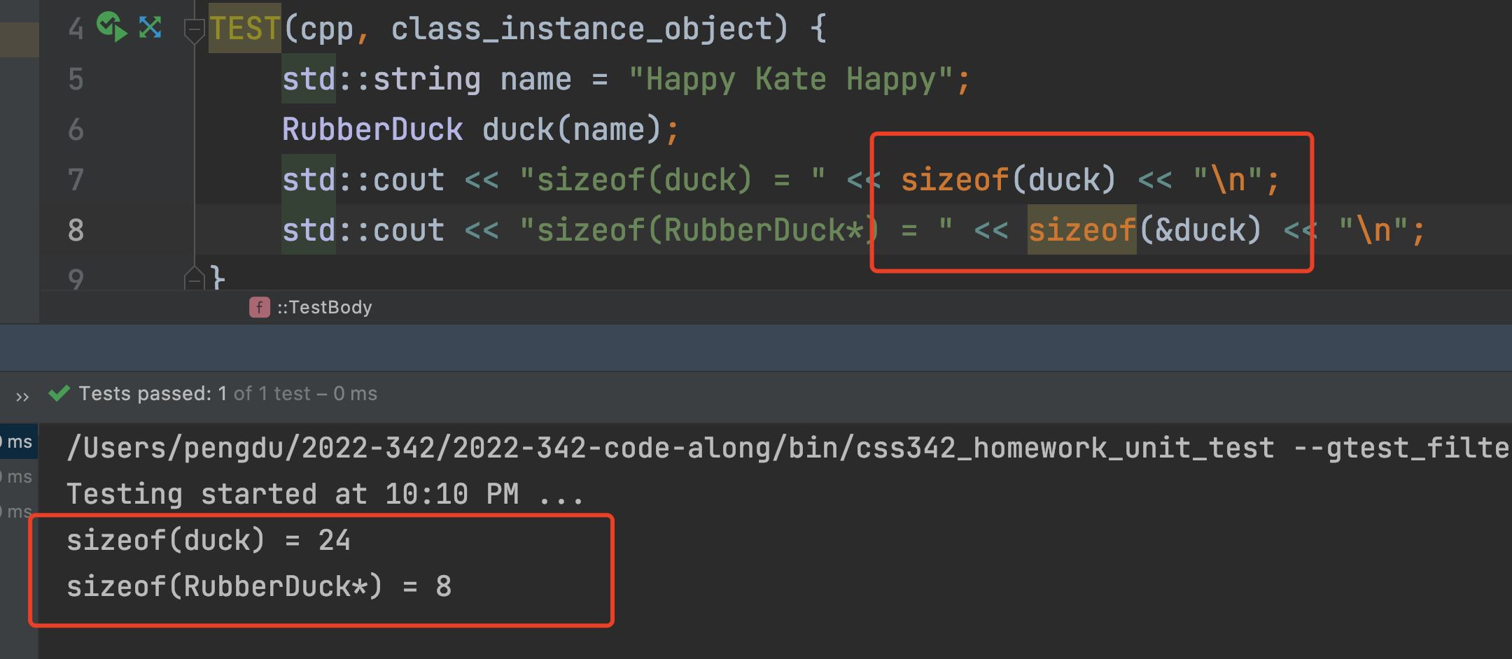
Class Instance
Hexadecimal Address
0x0
1 byte (8 bits)
0x8
0x10
0x18
… …
duck
sizeof(int*)
24 bytes

Slide 8
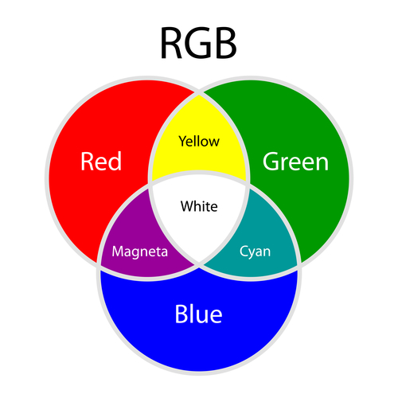
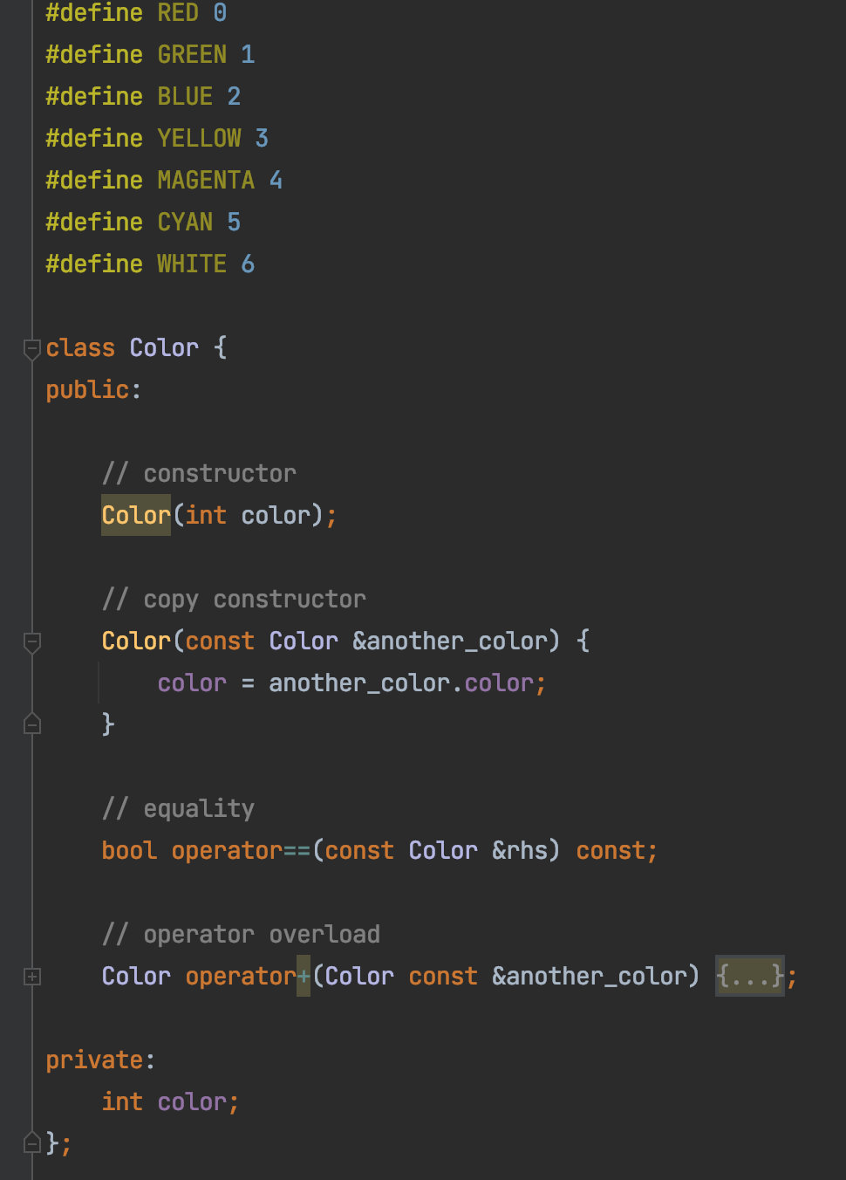
Operator Overload (+)
Code here

Slide 9
Inheritance
Animal Class
Name
Gender
Age
Dog Class
Cat Class
Name
Gender
Age
Name
Gender
Age

Slide 10
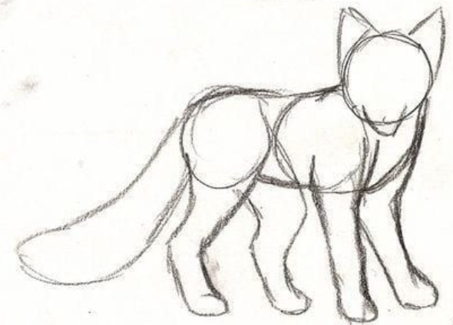
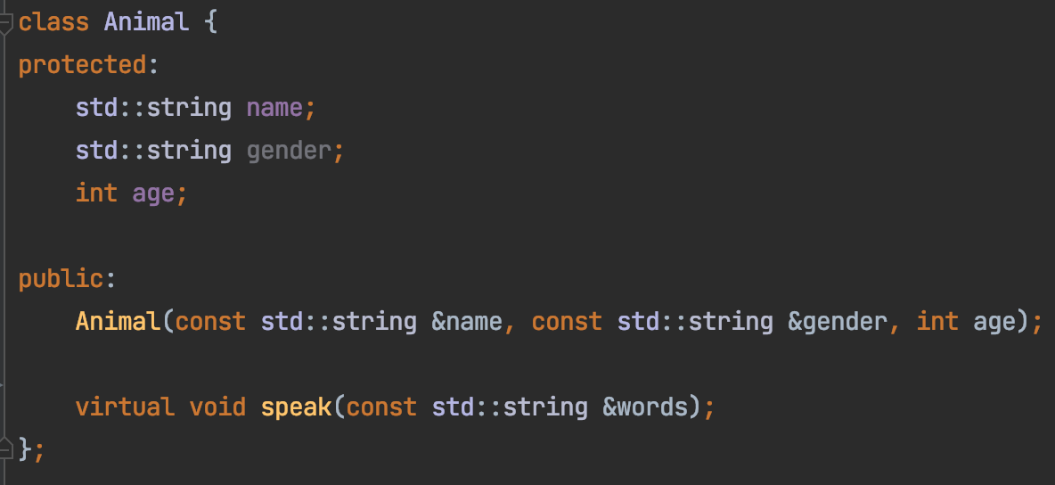
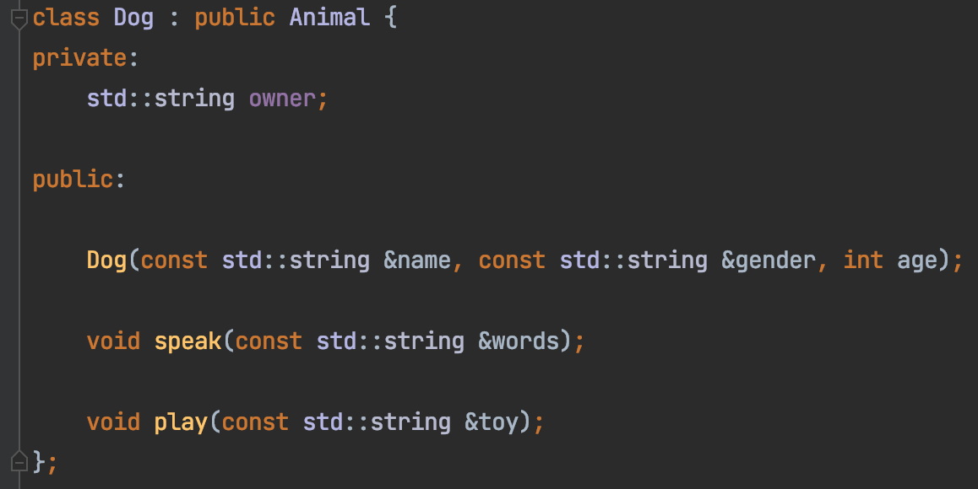
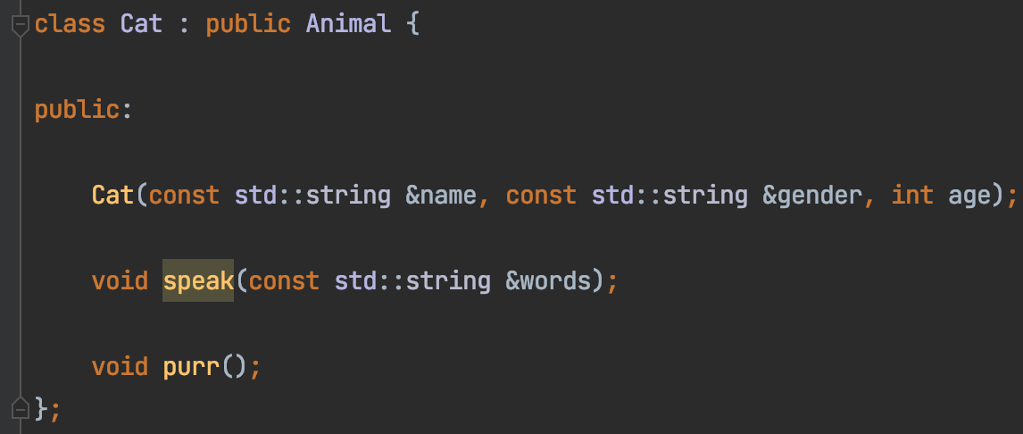
Inheritance

Slide 11
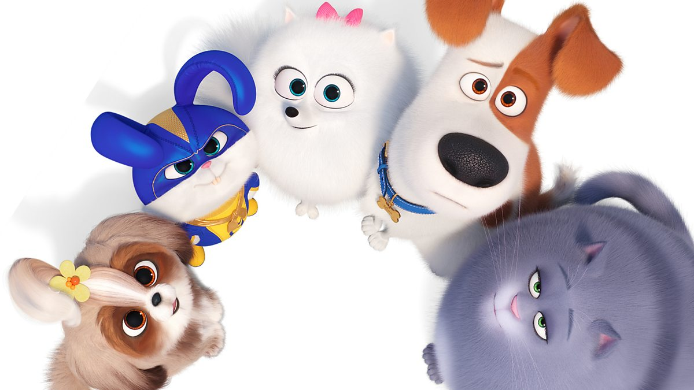
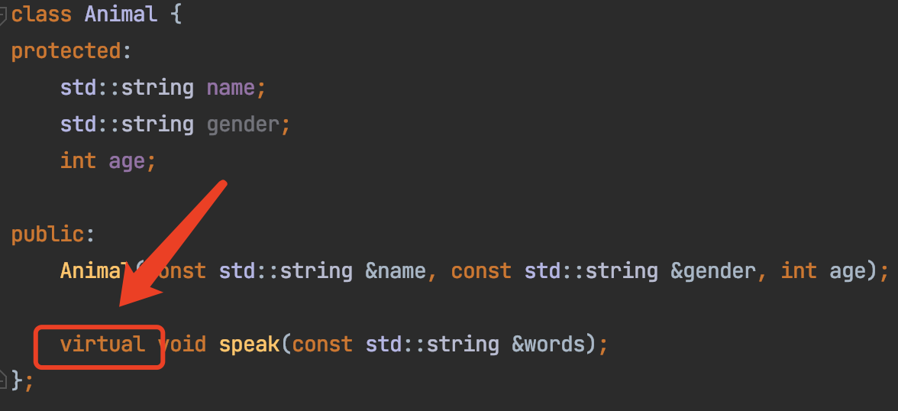
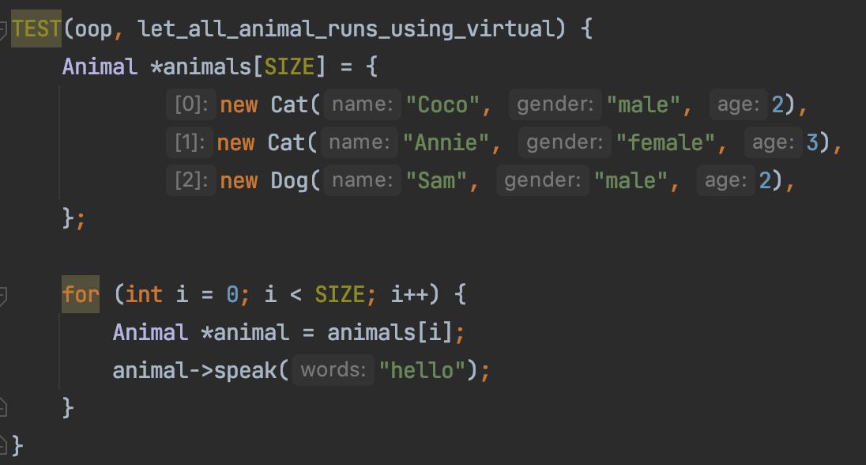
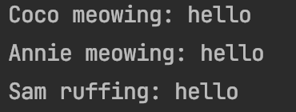
Let all animals play
Code here

Slide 12
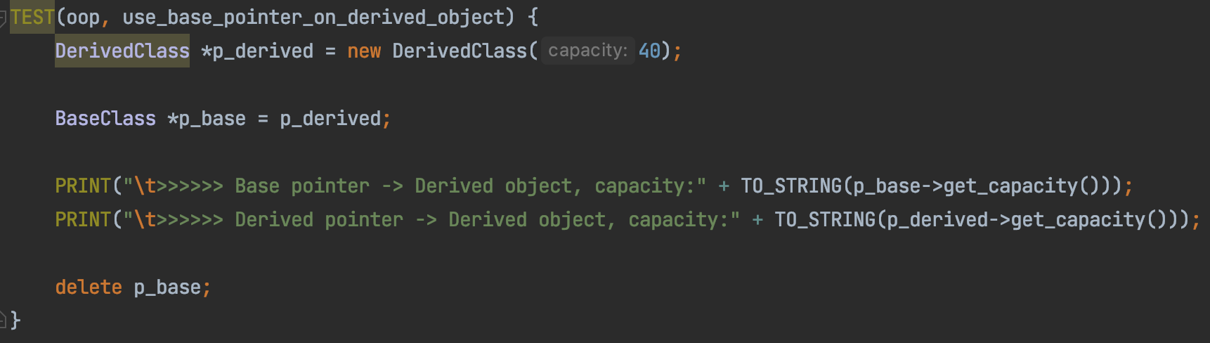
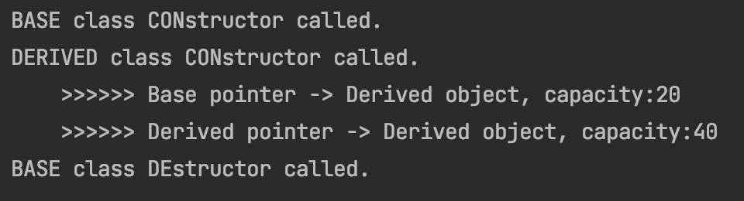
Virtual Destructor
Derived destructor NOT called → Memory leak!

Slide 13
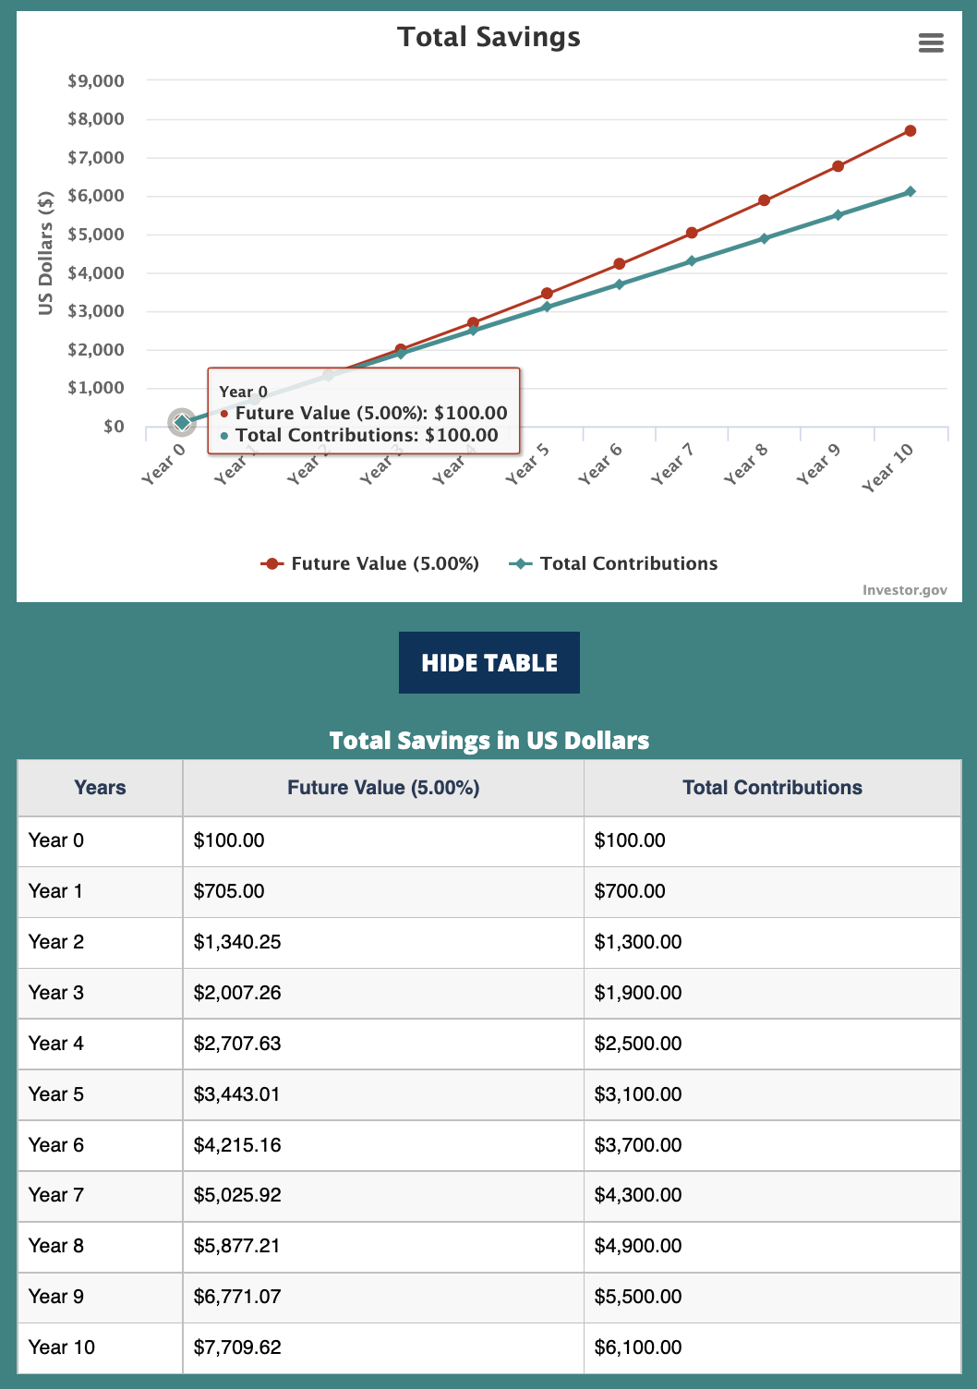
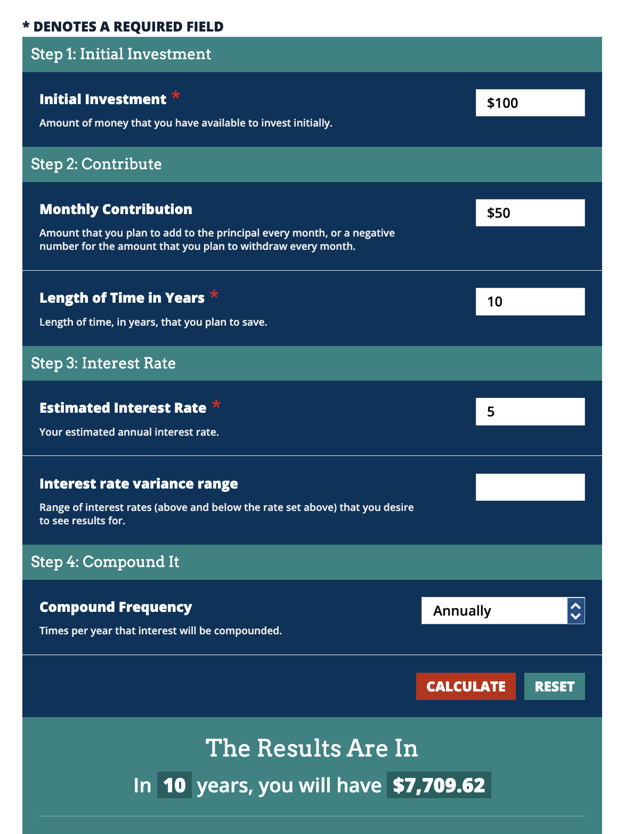
Example

Slide 14
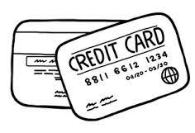
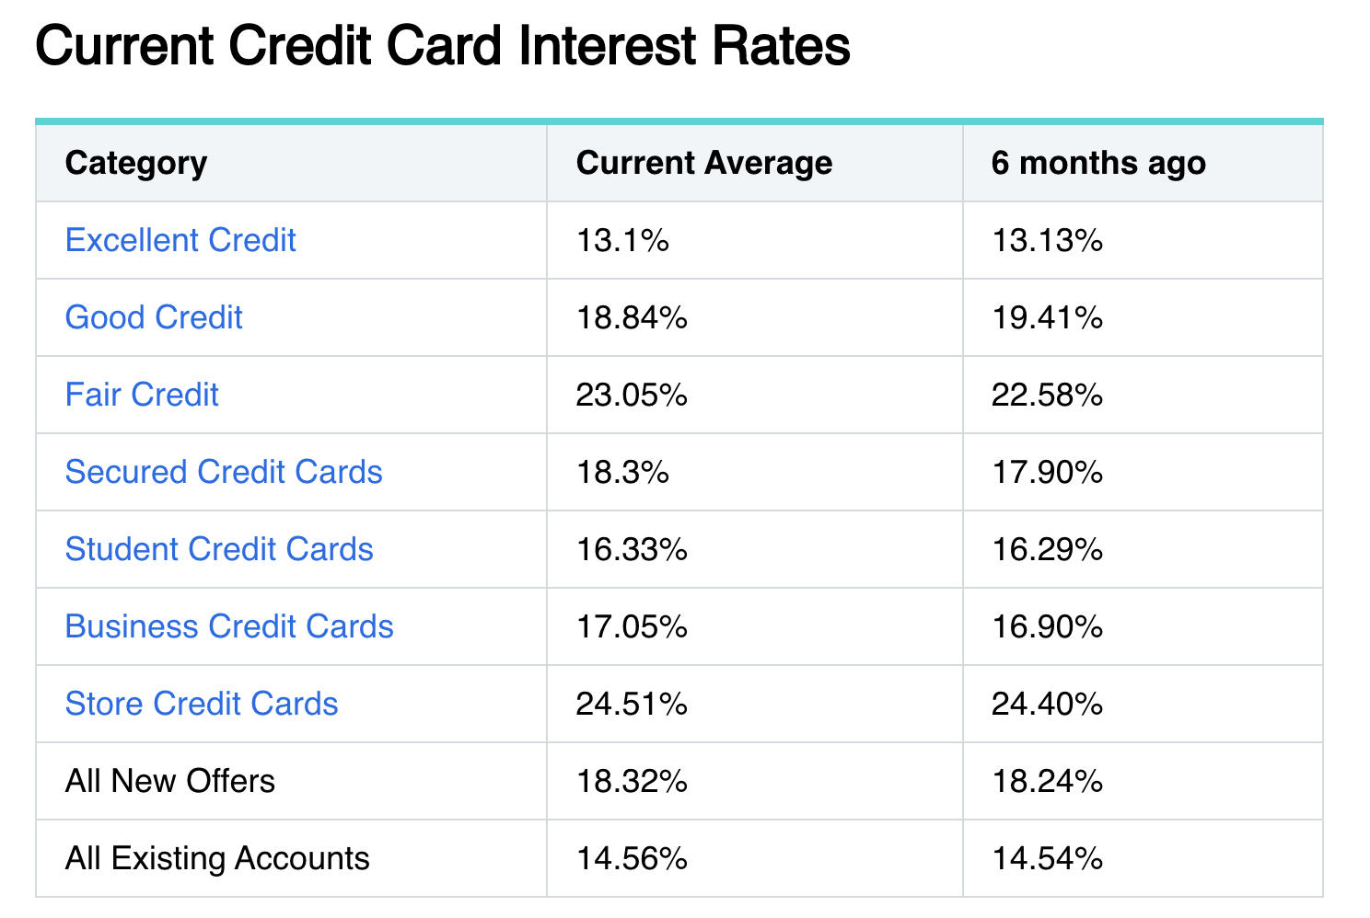
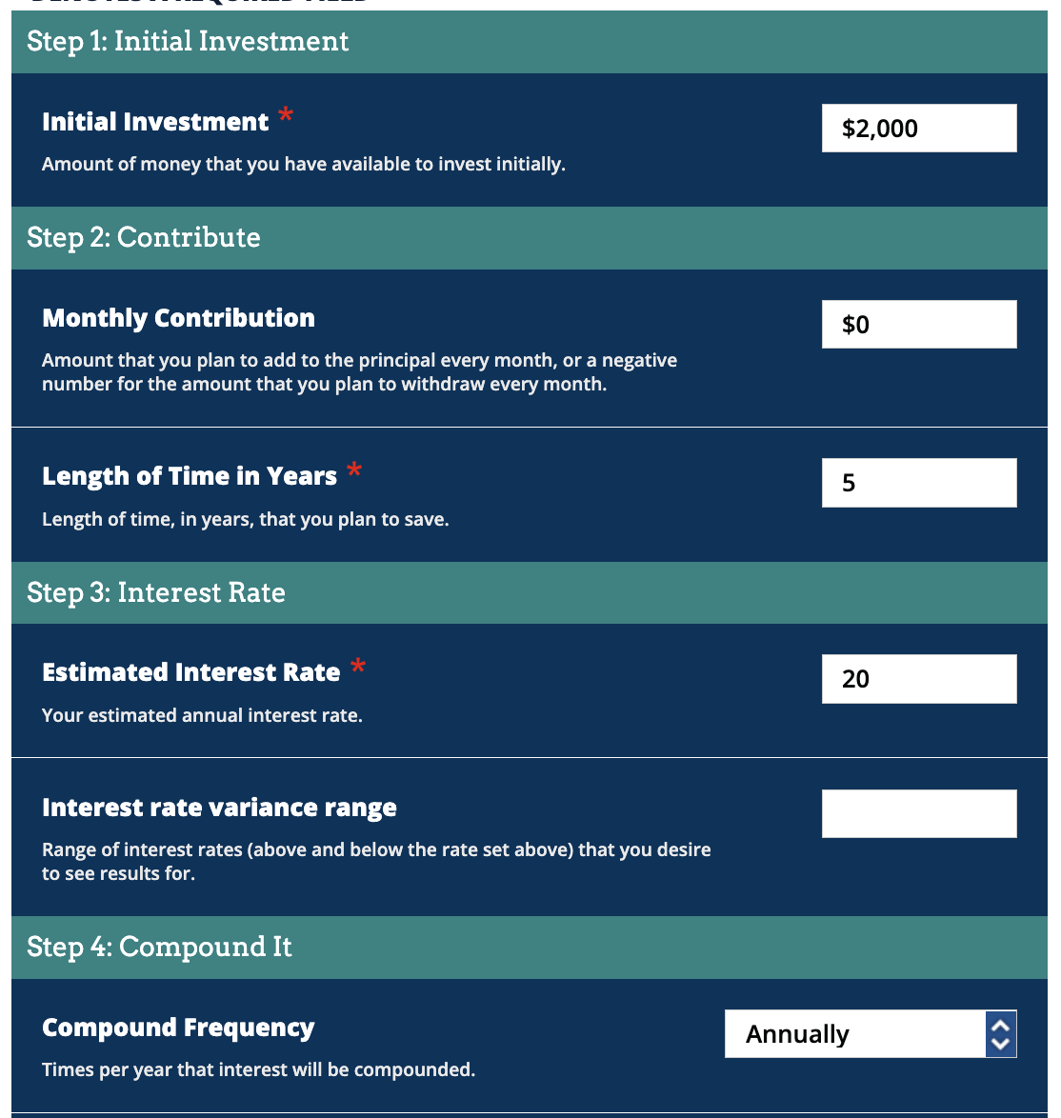
Example (the bad way)
How much do you own the bank after 5 years?
4,976.64
Use the web calculator here

Slide 15
Compound Interest
What’s your take?
“Money isn’t all that useful unless you know what to do with it.”
- Jordan Peterson
“The best thing money can buy is your (financial) freedom.”
- Rob Berger

Slide 16
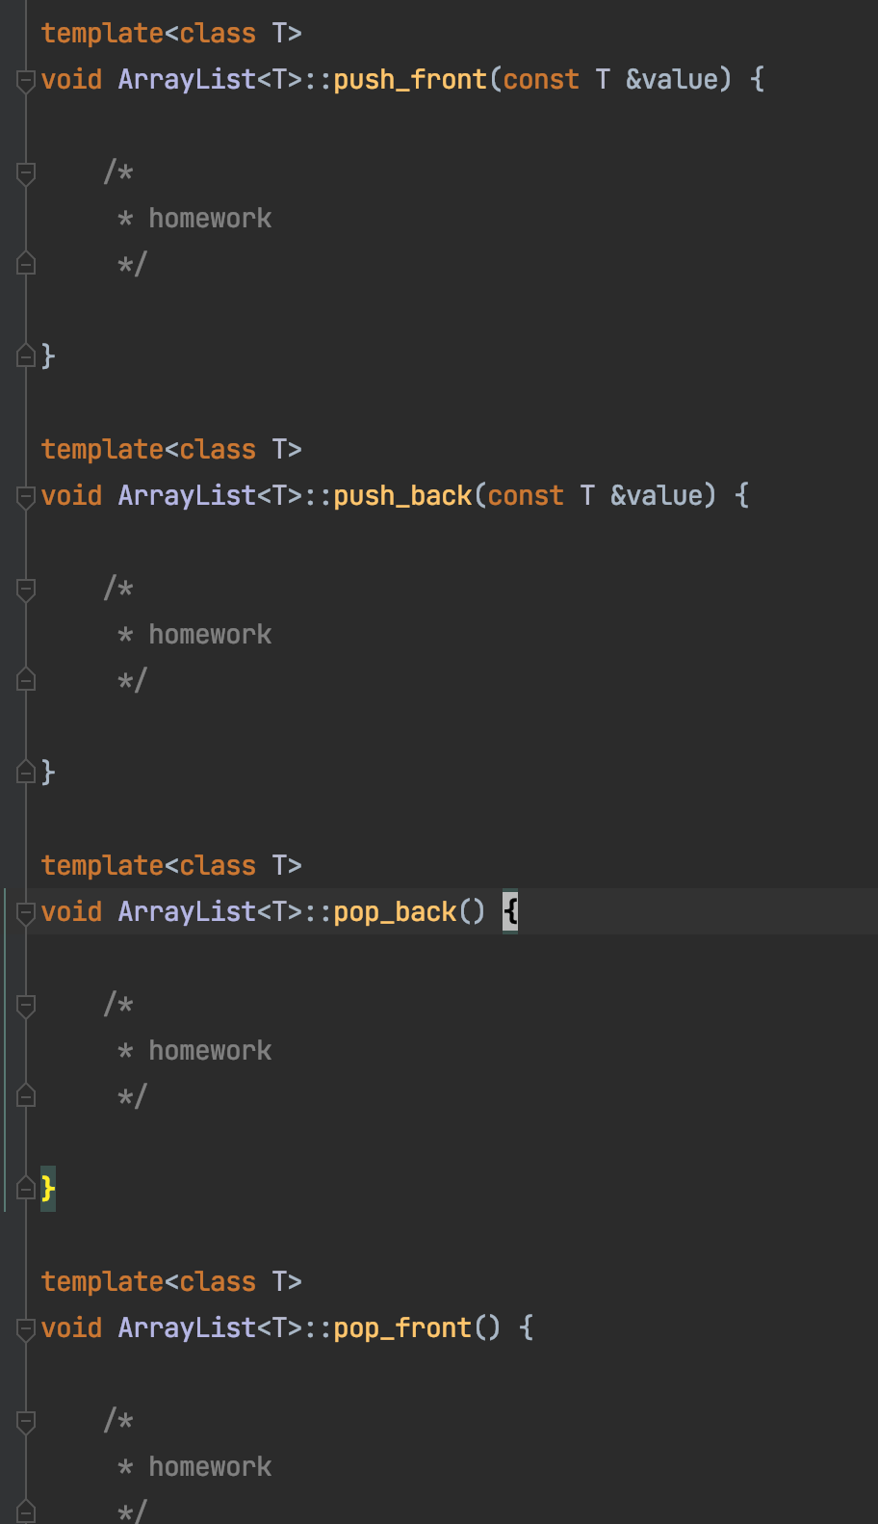
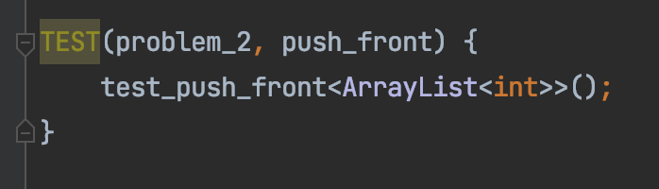
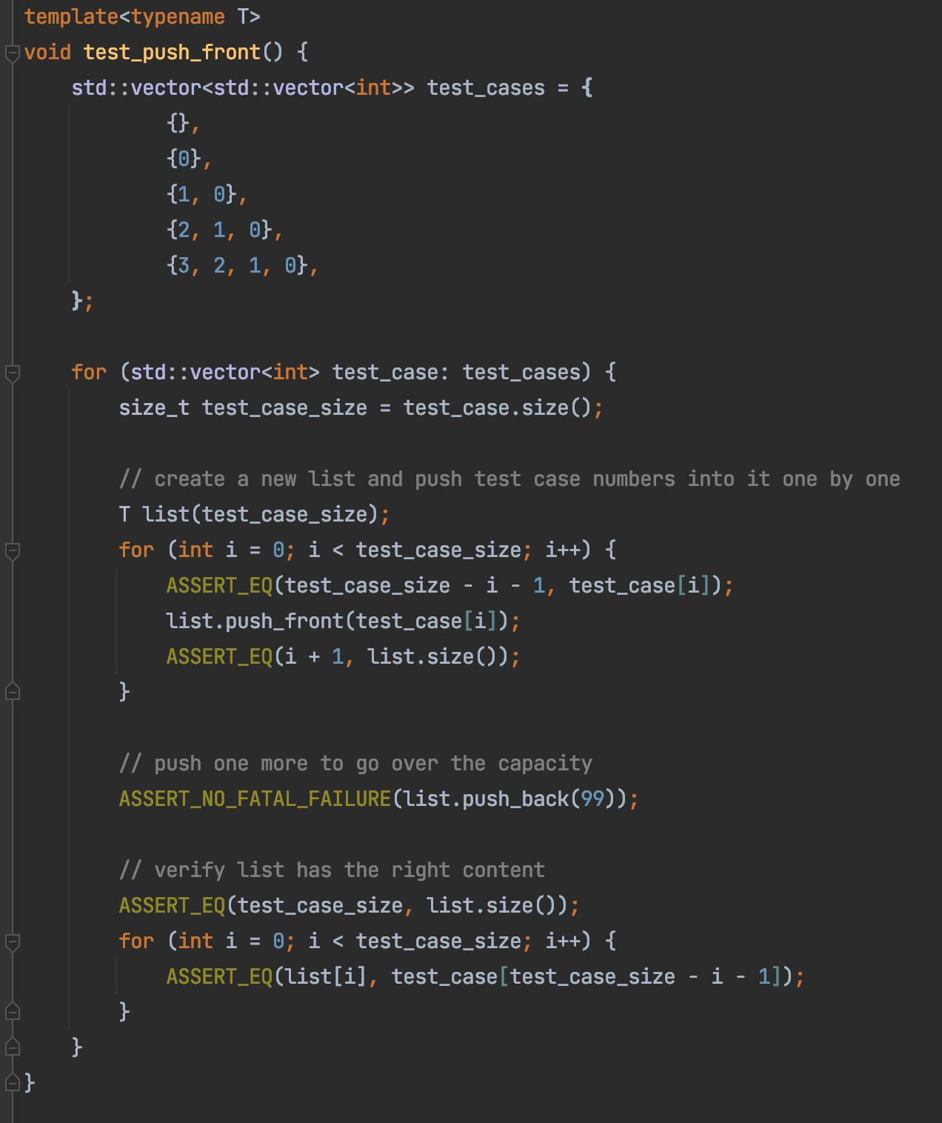
Use Unit Test As Manual
Read the “manual”

Slide 17
Abstract Data Type (ADT)
Interface
Public functions
Implementation
- Internal details

Slide 18
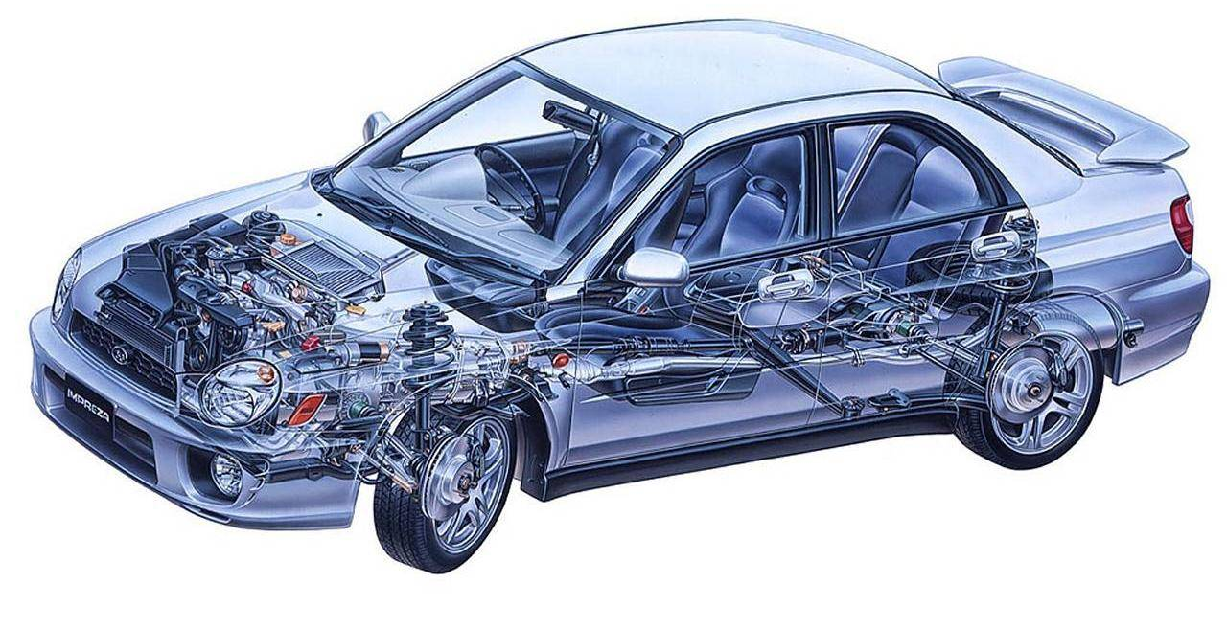
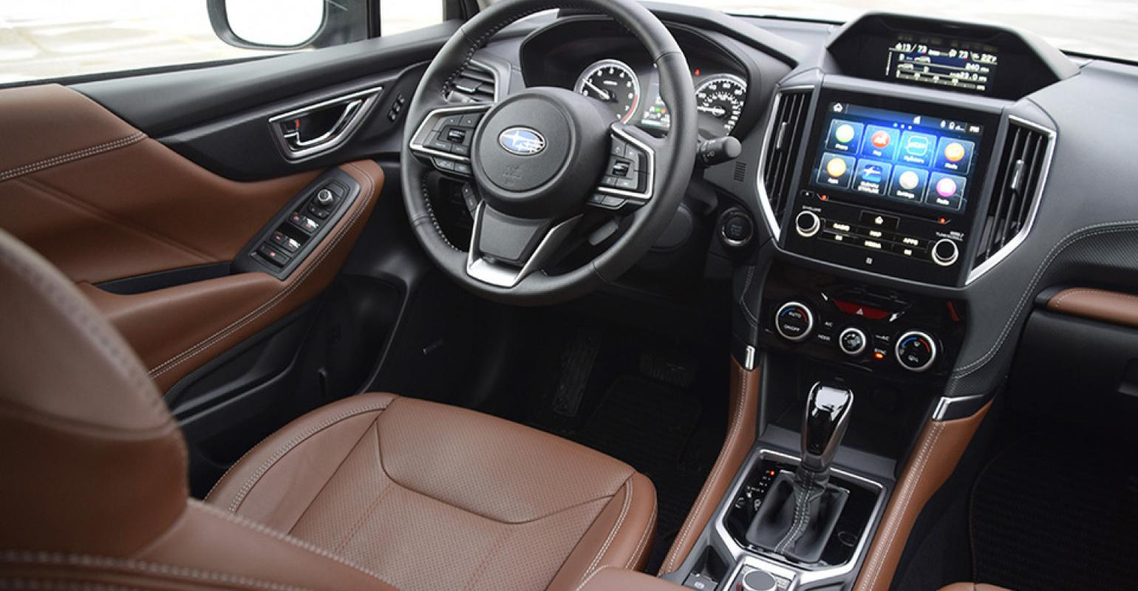
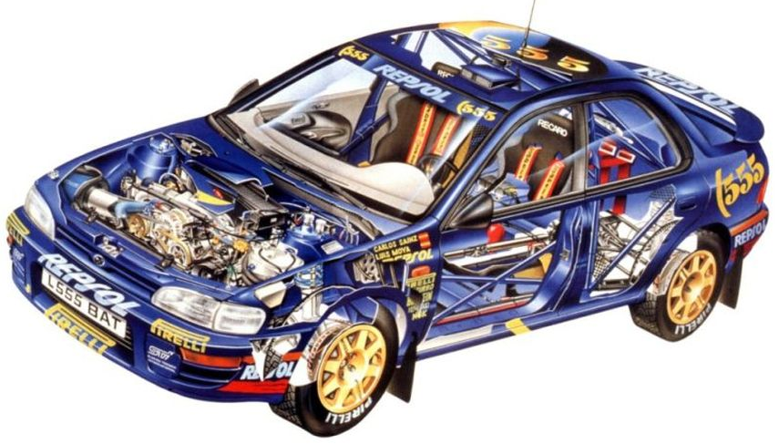
“Interface vs Implementation”

Slide 19
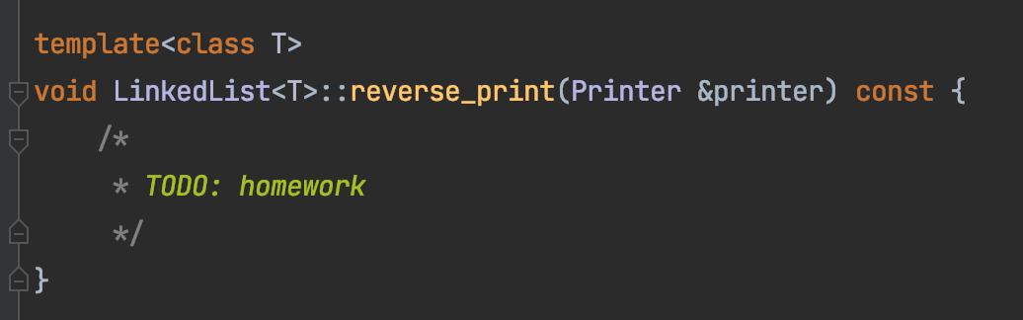
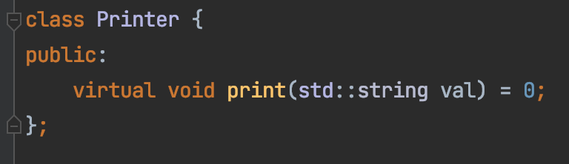
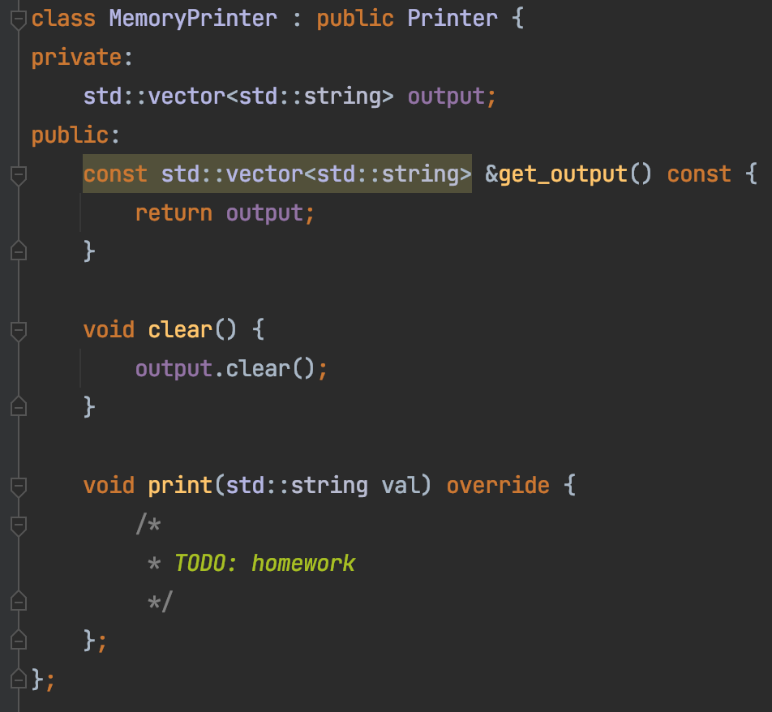

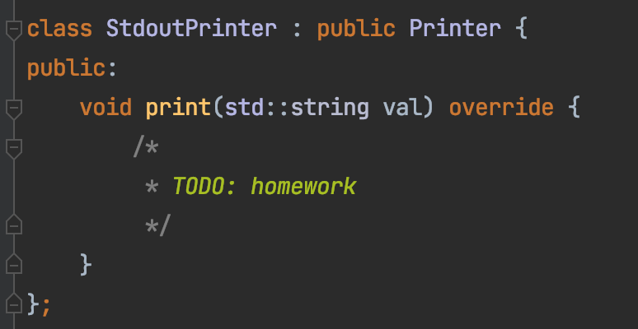
Homework 4 – Task 1
Decouple our code from how print is done
Interface
Implementation – For real use
Implementation – For testing

Slide 20
Memory Layout
list
array
Memory space

Slide 21
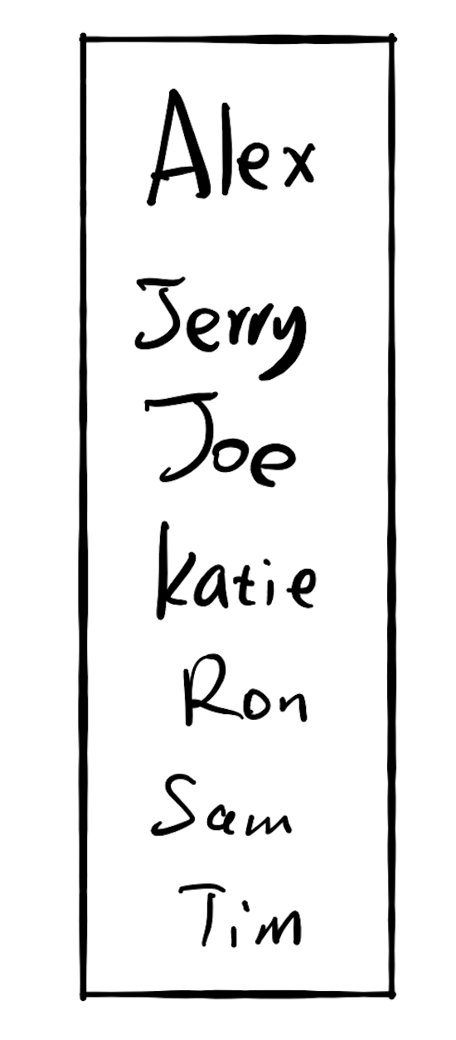

Fast for search
Slow for insertion
Slow for search
Fast for insertion

Slide 22
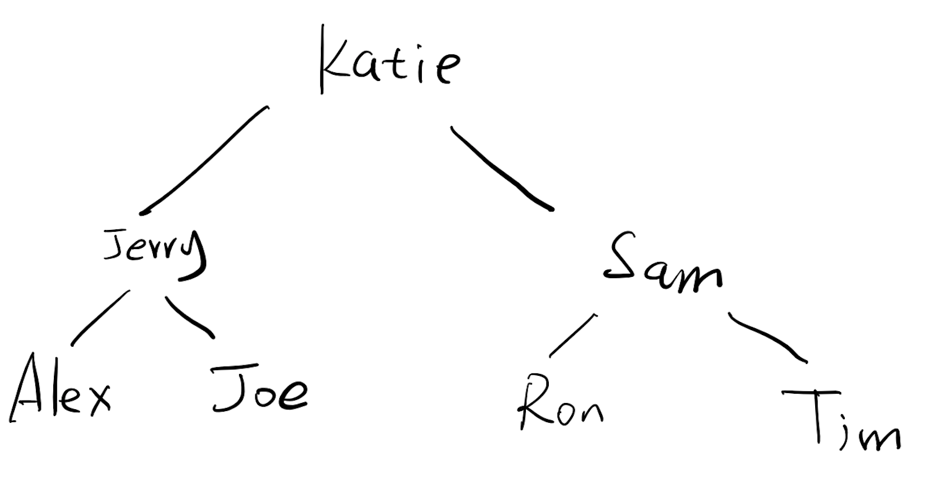
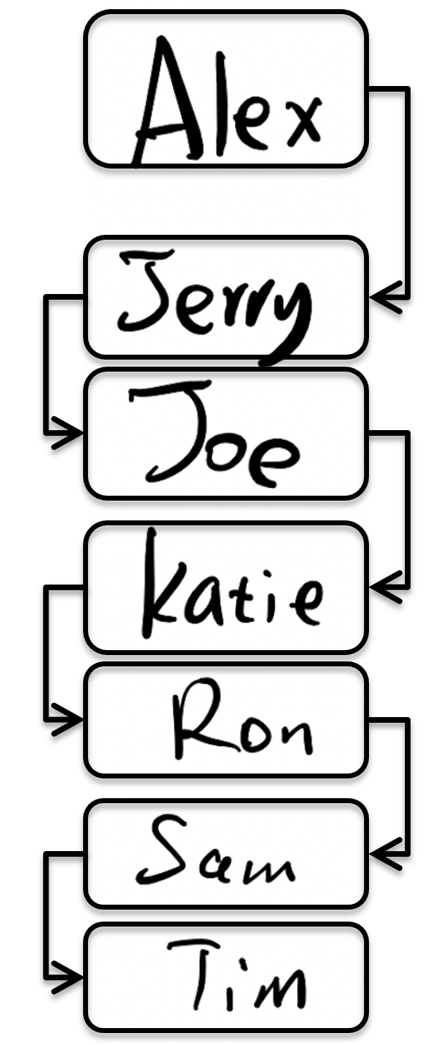
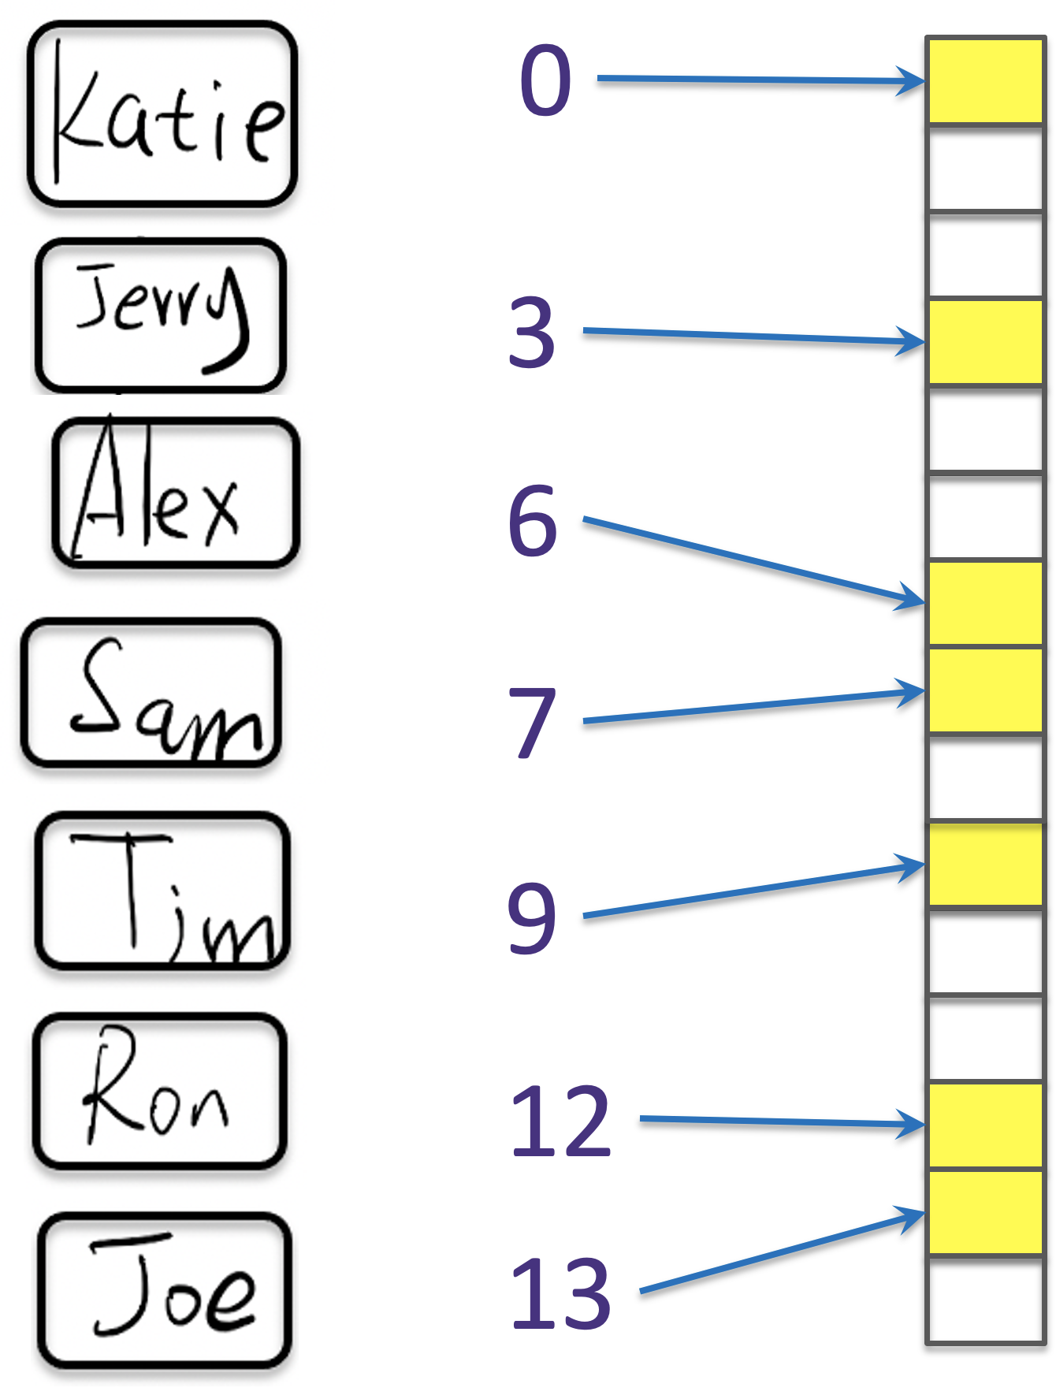

Slide 23

Key value pair: (K, V)
(K,V)
Hash function
6
Hash key
key K

Slide 24
Word Frequency
Give a text of words
You can't handle the truth! Son, we live in a world that has walls, and those walls have to be guarded by men with guns. Who's gonna do it? You? You, Lieutenant Weinberg? I have a greater responsibility than you can possibly fathom. You weep for Santiago and you curse the Marines. You have that luxury. You have the luxury of not knowing what I know, that Santiago's death, while tragic, probably saved lives. And my existence, while grotesque and incomprehensible to you, saves lives! You don't want the truth, because deep down in places you don't talk about at parties, you want me on that wall. You need me on that wall. We use words like "honor", "code", "loyalty". We use these words as the backbone of a life spent defending something. You use them as a punchline. I have neither the time nor the inclination to explain myself to a man who rises and sleeps under the blanket of the very freedom that I provide, and then questions the manner in which I provide it! I would rather you just said "thank you", and went on your way. Otherwise, I suggest you pick up a weapon, and stand a post. Either way, I don't give a damn what you think you are entitled to!
“A Few Good Men” https://www.youtube.com/watch?v=9FnO3igOkOk
Count how many times each word/sentence appears.

Slide 25
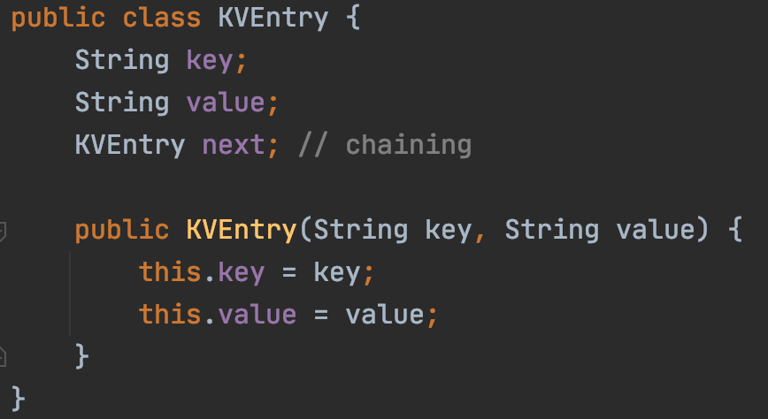
Collision
Sam
Ron
key=Sam
key=Ron

Slide 26
If there are 10,000 users
Each comparison takes 1 seconds
Sam
Ron
Alex
Jerry
Katie
Joe
Tim
2.78m ☹
~1s

Slide 27
LinkedList → Tree
Sam
Ron
Alex
Tom
Joe
Tim
Alex
Joe
Ron
Sam
Tom
Tim

Slide 28
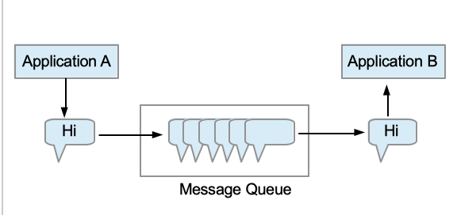
Message Queue
Goal: Allow different applications to work at different speed
Messaging queue (MQ) is used for asynchronous application to application communication.
https://medium.com/@Mohitdtumce/what-is-message-queue-b5468ff6db50

Slide 29
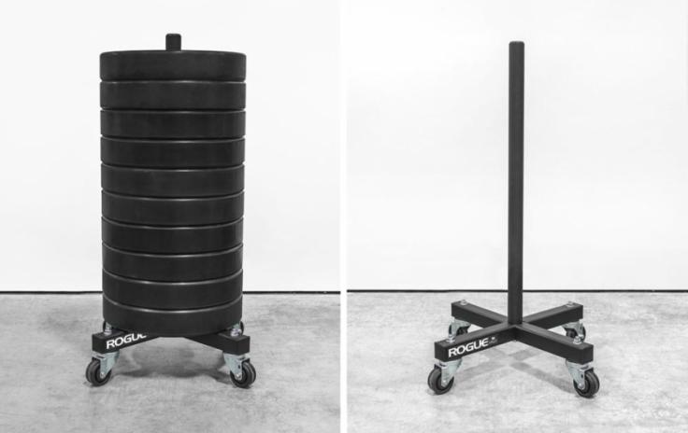
Stack ADT
push(…)
pop()
push(…)
pop()
First In Last Out (FILO)

Slide 30
Binary Search Tree
A Binary Search Tree (BST) :
all the nodes follow the below-mentioned properties:
The left sub-tree of a node has a key less than or equal to its parent node's key.
The right sub-tree of a node has a key greater than to its parent node's key.

Slide 31
Code it up!
preorder: Root, Left, Right
Recursion
Middle node value
Preorder(left subtree)
Preorder(right subtree)
Subproblem?
Stopping condition?
Node == null

Slide 32
Code it up!
inorder: Left, Root, Right
Recursion
Inorder(left subtree)
Middle node value
Inorder(right subtree)
Subproblem?
Stopping condition?
Node == null

Slide 33
Code it up!
postorder: Left, Right, Root
Recursion
Postorder(left subtree)
Postorder(right subtree)
Middle node value
Subproblem?
Stopping condition?
Node == null

Slide 34

Search Tree: Binary Search Tree
9
9
3
12
1
5
10
14
7
12
18

Slide 35
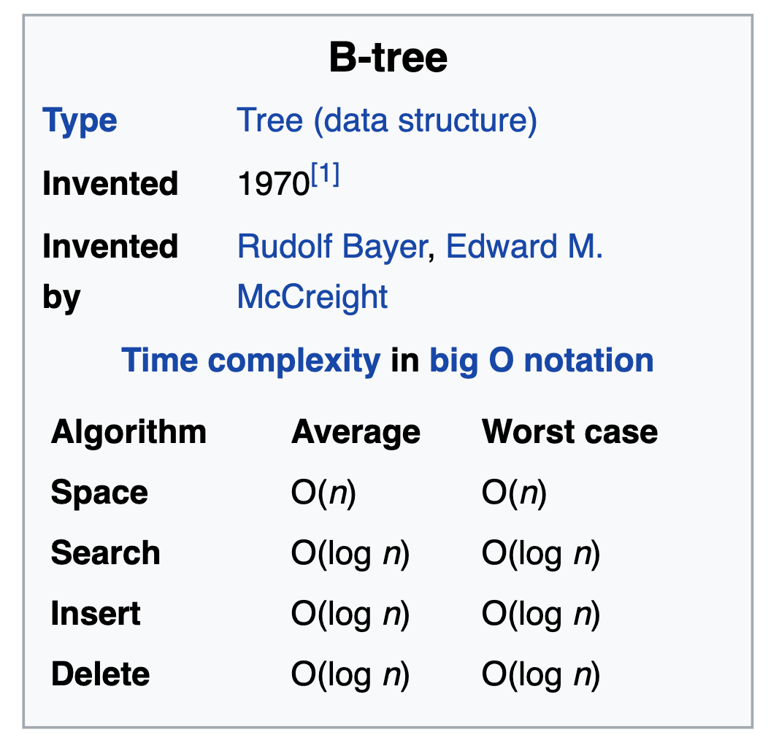
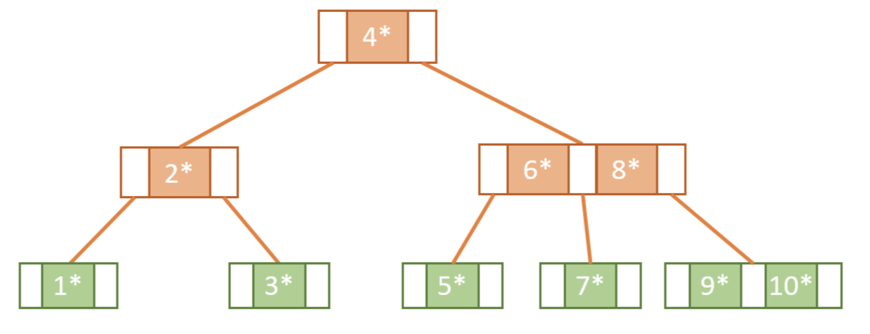
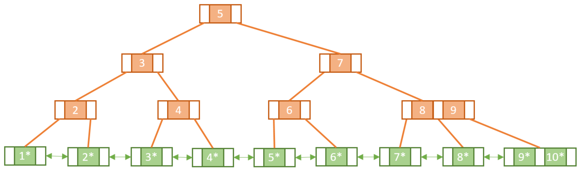
Search Tree: B, B+
B Tree
Visualizer
B+ Tree

Slide 36
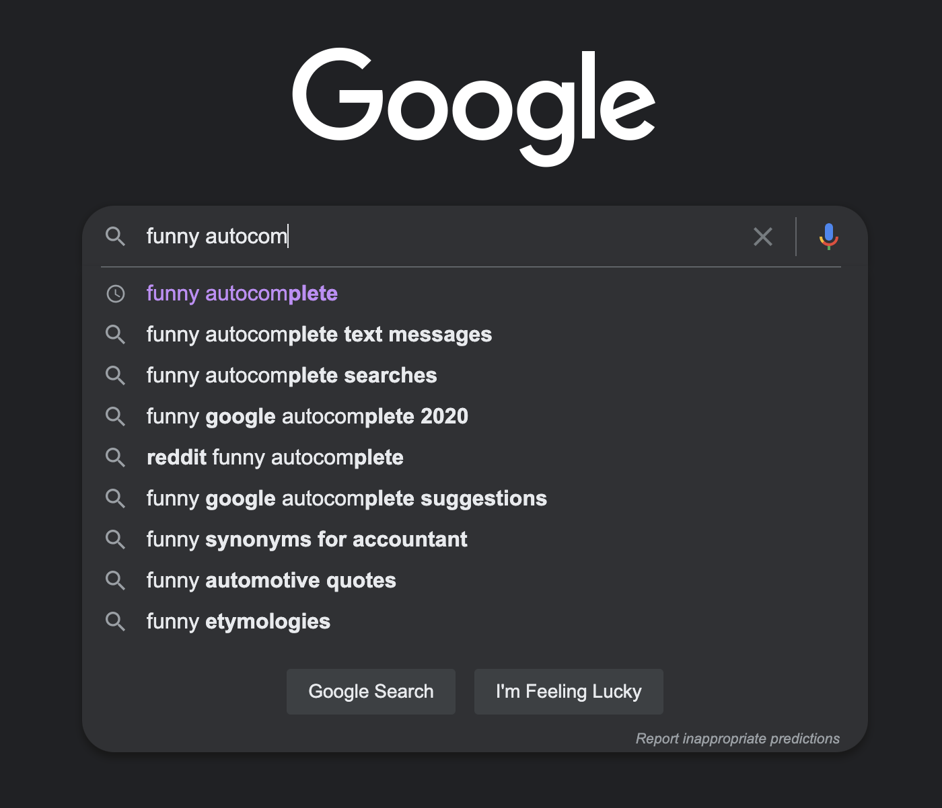
s
h
e
o
e
s
a
e
i
Seattle
Seatac
a
t
l
w
sea
g
t
-
l
t
a
h
l
o
c
e
#recursion

Slide 37
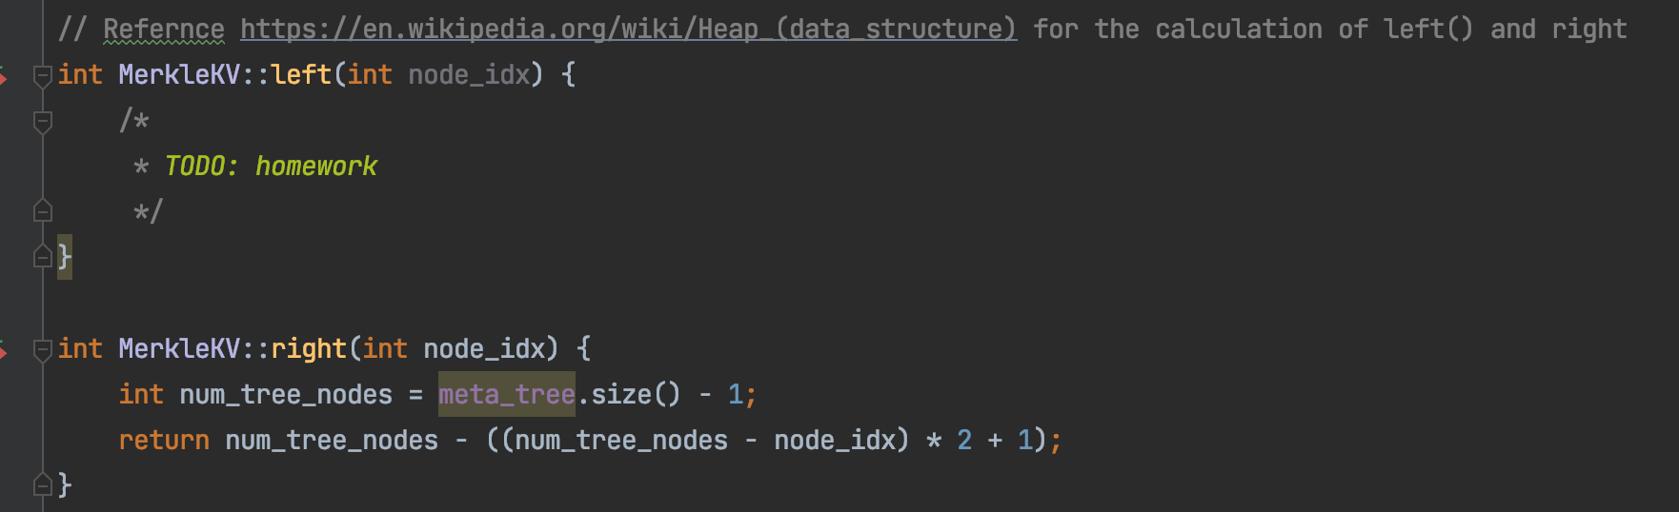
Heap, Tree Storage
8
7
6
4
3
5
2
1
0
1
2
3
4
5
6
7
8
7
6
4
3
5
2
1
0 → 1, 2
1 → 3, 4
2 → 5, 6

Slide 38


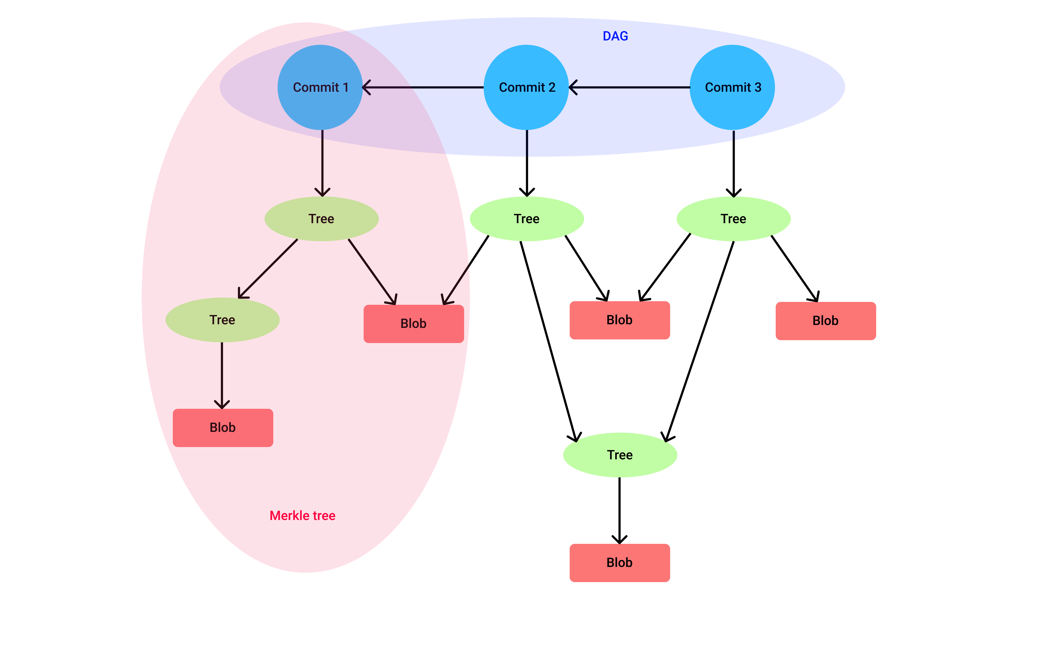
Validation Tree: Merkle Tree

Slide 39
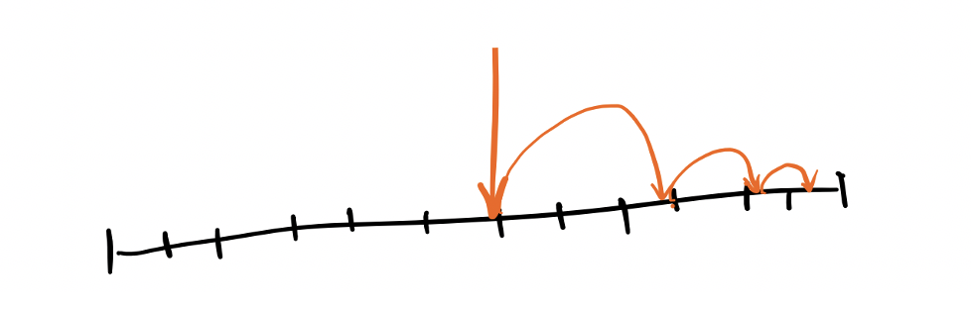
Searching Algorithm

Slide 40
If there are 10,000 users
13s
Each comparison takes 1 seconds
13s
2.78m
~1s

Slide 41
If there are 10,000 users
Each comparison takes 1 seconds
Sam
Ron
Alex
Jerry
Katie
Joe
Tim
2.78m ☹
~1s

Slide 42
Application of Tree: Search in a dataset
id
name
age
HashTable
0
Sam
40
1
Bob
25
2
Katie
33
Binary Search Tree
3
Ron
25
4
Tim
45
B Tree
5
Sam
20
…
…
…
…
…
…

Slide 43
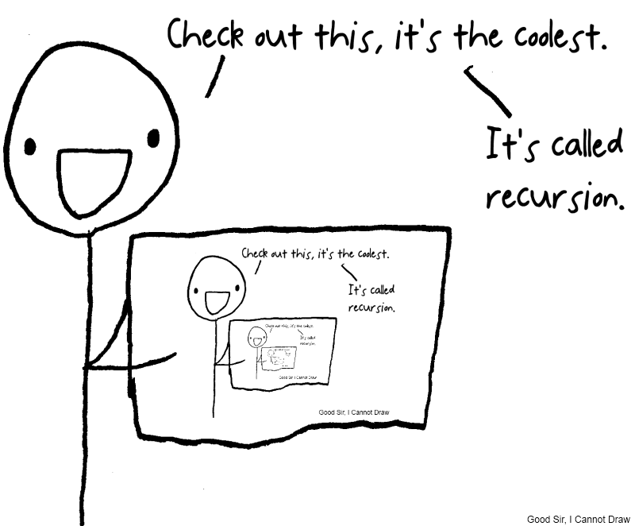
Recursion

Slide 44
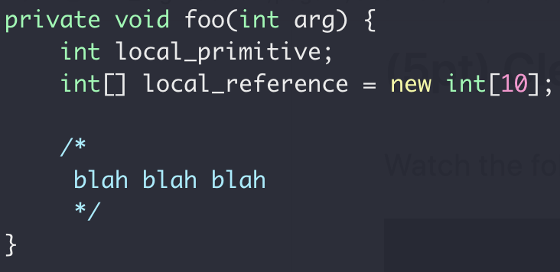
Function Call Stack
Heap
Int[10]
Stack
local_primitive
local_reference
Memory

Slide 45
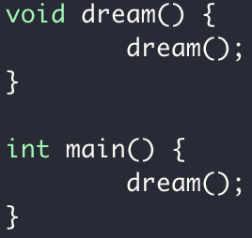
Stack For Function Call
stack for dream
stack for dream
stack for dream
stack for dream
stack for dream
stack for dream
stack for dream
stack for dream
stack for dream
stack for main

Slide 46


Buffer Overflow Attack
Local variable for good_code
stack for good_code
Write overflow
Return instruction address
stack for main
Stack smashing

Slide 47
Why Recursion?
Problem using as complex data structure
Problems of recurring nature

Slide 48



Recursion In Class Exercise: Unique Paths
A robot is located at the top-left corner of a grid
The robot can only move either down or right at any point in time.
$m$ rows
$n$ columns

Slide 49




Unique Paths Tests
uniquePaths(3,4)
1
2
3
4
3,4
2,4
1,4
1,3
1,2
1,1
1
2,3
1,3
1,2
1,1
2
$m$ rows
2,2
1,2
1,1
2,1
1,1
3
$n$ columns
uniquePaths(1,1) $×4$

Slide 50

Unique Paths Tests
uniquePaths(10,15)
Repeated subproblem

Slide 51
Unique Paths
Repeated subproblems
1
1
1
1
1
1
2
3
4
5
recursion
1
3
6
10
15

Slide 52
Unique Paths
Iterative solution
1
1
1
1
1
1
2
3
4
5
1
3
6
10
15
Dynamic programming FTW
How much memory storage space do you need?

Slide 53

Recursion Summary
When to use recursion
Depth First Search

Slide 54
Recursion Summary
When to use recursion
Try All Options
?
?
?

Slide 55



Backtracking

Slide 56
Sorting Algorithm & Complexity

Slide 57

Weighting 9 boxes
9 boxes, same size, equally heavy - except for one, which is a little heavier.
With a pair of balance scales, how to identify the heavier ball?

Slide 58
“Big O” notation
$$O(1)$$
Space
$$O(n)$$
Execution time
$$O(lgn)$$
Worst case scenario
$$O(nlgn)$$
$$O(n^{2})$$

Slide 59

$$O(n)$$
Speed of increase as $n$ grows
$$O(1)$$
$$O(lgn)$$
$$O(nlgn)$$
$$O(n^{2})$$

Slide 60



$$O\left(n^{2}\right) vs O(nlgn)$$

Slide 61

Prove:
$f\left(n\right)= 1+2+…+n=\frac{n(n+1)}{2}$
Your code
Correct answer $∀n$
$n=1$
$f(1)=1$
Your tests
$n=2$
$f(2)=3$
$n=5$
$f\left(5\right)=1+2+3+4+5=15$

Slide 62

Why the “rubber duck”?
Think out LOUD
Talk to the Duck
https://rubberduckdebugging.com
https://www.youtube.com/watch?v=huOPVqztPdc

Slide 63
Tips for Success
Good Sleep
Maintain good sleep
“Sleep” on it
Study Smart
Make small improvement everyday
Tracking progress (write log, blog, vlog…)
Practice, practice, practice (read/write code)
Communicate
If you have trouble with something, very likely you are not the only one
Ask the instructor (on Discord)
mistake, stuck → “opportunity to improve”

Slide 64

Technical Debt Log
Technical Debt: Topics that you should’ve understood but not yet.
Keep a journal throughout the semester (somewhere only you can see, e.g. a private GitHub repo)
Date | Debt Topic | Plan To Fix | Status
Bring this to 1:1 discussion
Weekly log throughout semester 10pt → extra credit on Final

Slide 65

Virtual machine
Detailed guide here
If you use Windows, watch this too

Slide 66


Makefile

Slide 67



Memory Checker

Slide 68

Clean Code

Slide 69



Write Solid Code

Slide 70
Clean Code
Don’t Repeat Yourself

Slide 71


More on Clean Code
https://youtu.be/4F72VULWFvc
https://youtu.be/AeWbJ5LIFNg

Slide 72

Software Testing

Slide 73
Coding Procedures
First, write Tests
Test should fail
Then, implement Feature
Test should pass
And then, refactor
Test should still Pass

Slide 74
Testing
Why testing?
1. Validation
Is your code correct?
2. Prevent regression
Can your code be damaged by some else?

Slide 75


What do you do when a bug is found and to be fixed?
Fix the bug in the function
2. Fix the bug in the function and add a test for it
3. Add a test first, see it fails,
then fix the bug in the function,
and see the test pass

Slide 76




Test Driven Development
https://youtu.be/d1EAyR_NCOA
https://youtu.be/a6oP24CSdUg
https://youtu.be/KyFVA4Spcgg
https://youtu.be/fr1E9aVnBxw

Slide 77

https://medium.com/paul-heintzelman/own-your-code-8a06ecff1a32

Slide 78


Git & GitHub
Git:
Keep versions of your code, on your machine
Each “version” is call a commit
You can have multiple branch of commits
https://git-scm.com/downloads
GitHub: Keep git repository online
https://github.com/

Slide 79



Submission Checklist
https://github.com/a-teaching-goose/CSS342A-2022-Spring/blob/main/homeworks/submission_checklist.md
1
Before Coding Checklist
3
Submission Checklist
2
Coding Checklist

Slide 80

Parkinson’s Law
“Work complicates to fill the available time.”
Given 4 days, I’ll start work on day 3
Given 7 days, I’ll start work on day 6
Given 10 days, I’ll start work on day 9

Slide 81

Beat Parkinson’s law
LINK
Have a plan
Have an estimate
Keep track of how long it takes for you to do a homework
Baby steps
Low hanging fruits
Fork, clone, new branch and PR
Compile code
Run tests

Slide 82
Ask the Right Question
“my code is failing with test case # ….
The specific error is …
I have checked … and ….”
Compiler error
Test case log
Code Logic
Debugger (breakpoint, stepping)
Memory issue (Linux)
Just google the damn error message!

Slide 83
Study Priority
Lecture PPT
Homework Code
Your code
Given code, e.g. tests
C++
Textbook
In-lecture demo
Code-along
Example code
Your technical debt items

Slide 84
Study Priority For Exams
C++
Sample Exam
Textbook
Code-along
Homework Code
Your code
Provided solution
Your technical debt items

Slide 85
Why the “rubber duck”?
Think out LOUD
Talk to the Duck
https://rubberduckdebugging.com
https://www.youtube.com/watch?v=huOPVqztPdc

Slide 86
Tips for Success
Good Sleep
Maintain good sleep
“Sleep” on it
Study Smart
Make small improvement everyday
Tracking progress (write log, blog, vlog…)
Practice, practice, practice (read/write code)
Communicate
If you have trouble with something, very likely you are not the only one
Ask the instructor (on Discord)
mistake, stuck → “opportunity to improve”

Slide 87
Technical Debt Log
Technical Debt: Topics that you should’ve understood but not yet.
Keep a journal throughout the semester (somewhere only you can see, e.g. a private GitHub repo)
Date | Debt Topic | Plan To Fix | Status
Bring this to 1:1 discussion
Weekly log throughout semester 10pt → extra credit on Final

Slide 88

Homework & Final projects
Fun (new) problems !!
Compound Interest (C++, floating point numbers)
Latency evaluation via percentile (C++)
Media store Inventory manager (OOP)
Testing std::out (TDD)
Sudoku Solver (recursion, backtracking)
Matching parenthesis of ”any” size (recursion)
”SAGA” message queue pattern for distributed system
Merkle tree (used in Github itself and similar idea in Blockchain)
Database indexing

Slide 89







Slide 90
Software Developer Life, Q/A
Do you enjoy coding?
SDE Life
Programming languages
SDE vs DevOps vs Data Science vs PM
Industry vs Academia
Technical Interview
Soft Skills

Slide 91



Well, THIS IS IT!

Slide 92



Stay in Touch
Rally Racing
Working
https://github.com/a-teaching-goose
https://www.linkedin.com/in/peng-du-ph-d-14b0a11b/
Photography
https://www.instagram.com/fatgoooose
Comic design and drawing by @percima.art

